Slide 1
Control Structures
Mirzoulugbek Yusupov

Slide 2
Control Structures
What are Control Structures?
Control the flow of execution in a program.
Conditional Statements – Execute code based on conditions.
Loops – Repeat code multiple times based on conditions.

Slide 3
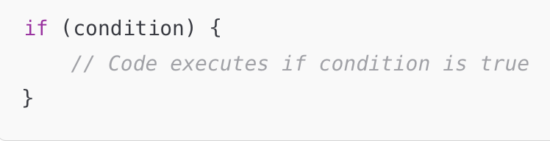
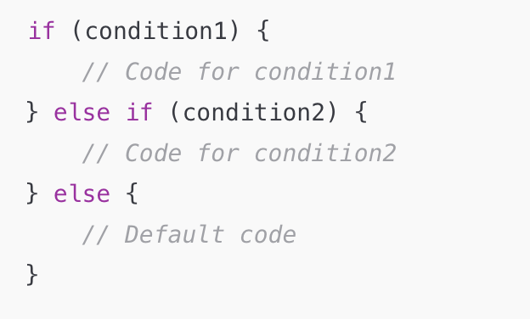
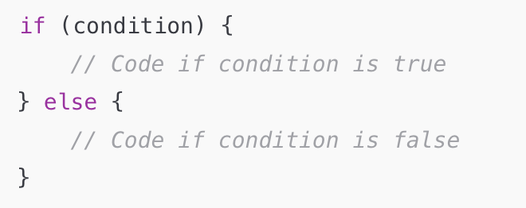
Conditional Statements
Used to execude specific blocks of code based on conditions

Slide 4
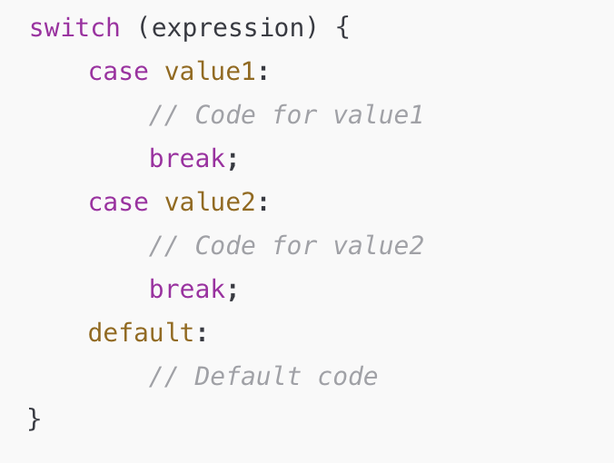
switch Statement

Slide 5
Loops Overview
Loops allow repeating a block of code multiple times.
while statement
for statement
do-while statement
for..in statement
for..of statement
Arrays and Objects

Slide 6
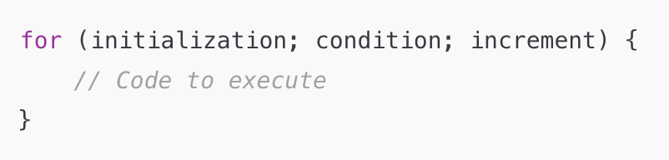
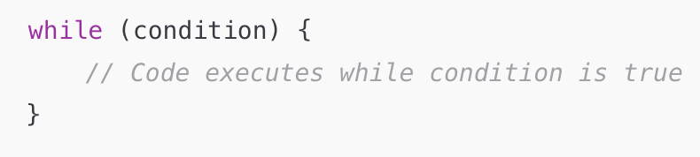
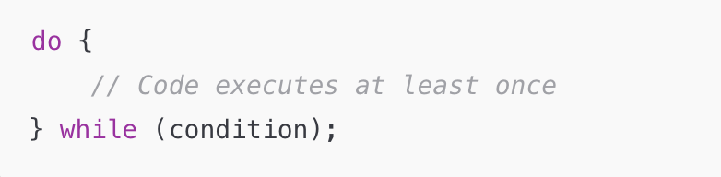
for & while & do-while

Slide 7
Practice
Write a JavaScript program that displays the largest integer among two integers
Write a JavaScript conditional statement to find the signed number in three numbers.
Display an alert box with the specified sign.
Sample numbers : 3, -7, 2
Output : The sign is –
Write a JavaScript conditional statement to sort three numbers.
Display an alert box to show the results.
Sample numbers : 0, -1, 4
Output : 4, 0, -1
Write a JavaScript for loop that iterates from 0 to 15.
For each iteration, it checks if the current number is odd or even, and displays a message on the screen.
Sample Output : "0 is even”, "1 is odd”, "2 is even"

Slide 8
Practice
5. Write a JavaScript program that iterates integers from 1 to 100.
For multiples of 3 print "Fizz" instead of the number
For multiples of 5 print "Buzz".
For numbers multiples of both 3 and 5 print "FizzBuzz".
6. Write a JavaScript program to find the Armstrong numbers of 3 digits.
Note : An Armstrong number of three digits is an integer such that the sum of the cubes of its digits is equal to the number itself.
For example, 371 is an Armstrong number since 3**3 + 7**3 + 1**3 = 371.

Slide 9
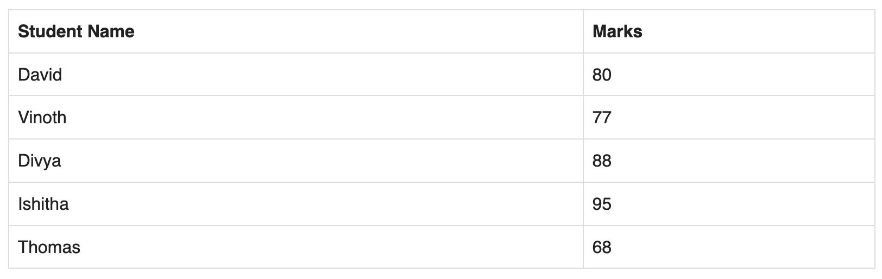
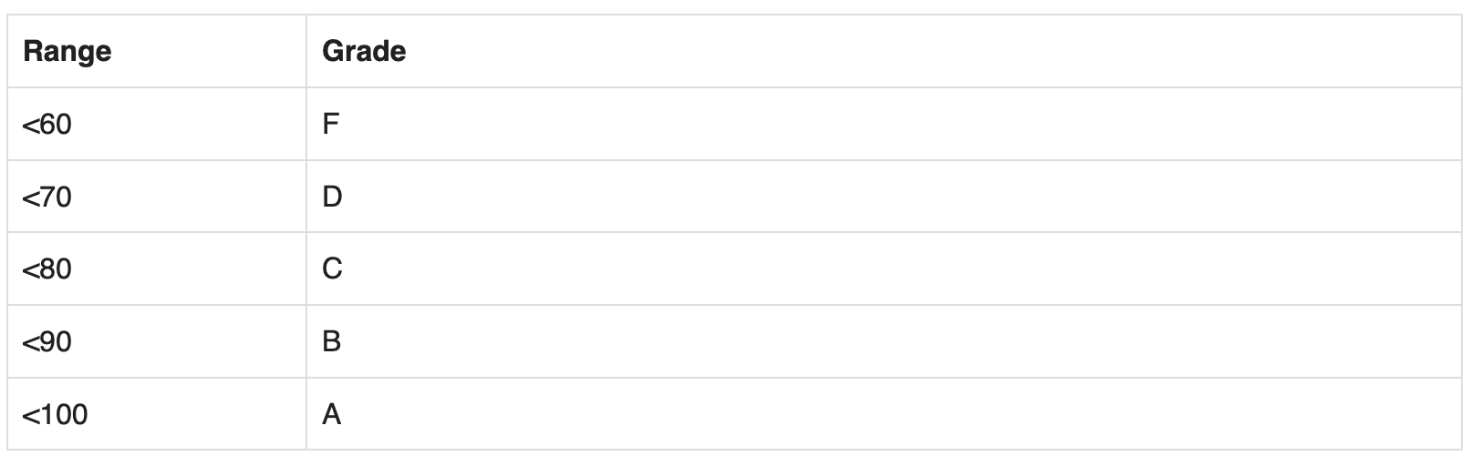
Practice
7. Write a JavaScript program that computes the average marks of the following students. Then, this average is used to determine the corresponding grade.

